Slide 1
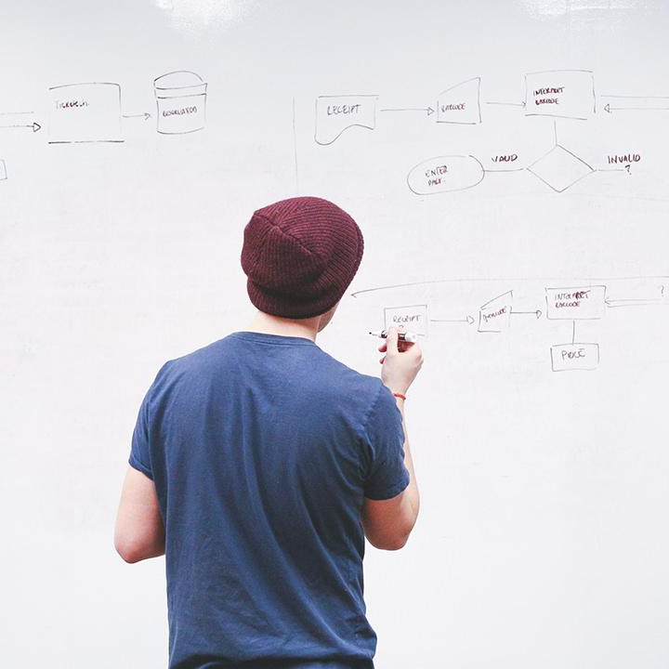
HELLO!
Here 1Crore Projects
I am here because I love to give presentations.
You can find me at @1CROREPROJECTS

Slide 2
Fortified Chain A Blockchain Based Framework for Security and Privacy Assured Internet of Medical Things

Slide 3

AIM OF PROJECT
The main aim of the project to identify a block chain by a different block for the data as patient details maintain safe mood in Particular Block chain.

Slide 4
ABSTRACT
We have introduced the hybrid computing paradigm with blockchain-based Distributed Data Storage System (DDSS) to overcome blockchain-based cloud centric IoMT healthcare system drawbacks like high latency, high storage cost and single point of failure. A decentralized Selective Ring based Access Control (SRAC) mechanism is introduced along with device authentication and patient records anonymity algorithms to improve the proposed systems security capabilities.

Slide 5
INTRODUCTION
The blockchain technology is a decentralized distributed ledger system which provides smart-contracts, and exhibits traceability, transparency in digital asset management.
The transactions in blockchain are represented as blocks linked together to form a chain of blocks. If one block or transaction is forced to alter, then we need to change the entire chain header information of that blockchain.

Slide 6
EXISTING SYSTEM
In before years the data does not save as in safe mood, the attackers are attack it directly and we cannot recover the data issues.
A decentralized architecture based on blockchain technology provides the ability to solve above issues

Slide 7
DISADVANTAGES
Lows of security
The user without login, Encrypted data cannot store in block chain

Slide 8
PROPOSED SYSTEM
we have proposed a novel architecture and cryptography methods for IoMT-based decentralized distributed smart healthcare systems to provide data privacy, security, traceability, low latency, low storage cost and availability data processing and analysis followed by decision making.
Moreover, it performs tasks related to data storage, access controlling, and anonymity along with blockchain based DDSS management.

Slide 9
ADVANTAGES
Data was secure
By the different fields create a unique block is used to search a user need.

Slide 10
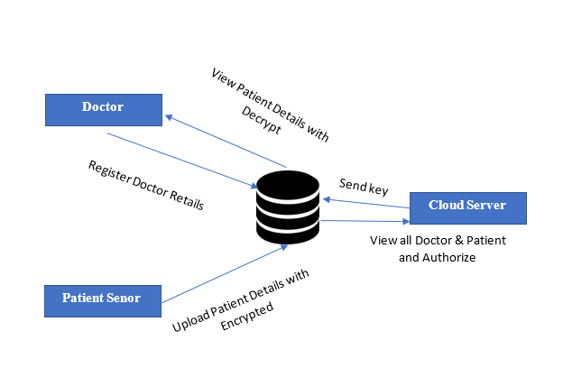



SYSTEM ARCHITECTURE

Slide 11
MODULES
In this project has three modules:
1. Cloud Server
2. Patient Sensor
3. Doctor

Slide 12
Cloud
Login
View and Authorize Doctor
View Clinical report
View Patient Details
Trace Patients by Blockchain
View Access Control Request
View Encryption Key Requests
View Key Transaction
View Result in chart
Logout

Slide 13
Patient Sensor
Register
View Profile
Read Sensor Patient Details
View Key Request
View Clinical Reports
Logout

Slide 14
Doctor
Login
View Profile
Read Sensor Patient Data & Add
View Sensor Patient Details
View Key Request
View Clinical Reports
Logout

Slide 15
HARDWARE REQUIREMENTS
System | Intel i3 and above
Hard Disk | 40GB
RAM | Minimum 4GB
Processor | 64-bit, four-core, 2.5 GHz minimum per core

Slide 16
SOFTWARE REQUIREMENTS
Front End Language | HTML, CSS, JAVA, JSP SERVELTS
Backend | My SQL
Operating System | Windows 10 or 11
IDE | JAVADEVELIPEMENKIT

Slide 17
FUTURE WORK
we will explore the techniques to leverage the intelligence to our system by using AI/ML technology. Our focus will be on future generation critical patient monitoring and assisting system framework requirements to deal with different types of pandemics.

Slide 18
CONCLUSION
we have elucidated a novel approach to solve the problems related to latency, data security, privacy, anonymity, and traceability in decentralized IoMT based smart healthcare systems. Moreover, it showcases the leverage blockchain, DDSS, and hybrid computing to deliver architecture level solutions to the discussed issues.

Slide 19
REFERENCE
[1] Y. Sun, F. P. Lo, and B. Lo, “Security and Privacy for the Internet of Medical Things Enabled Healthcare Systems: A Survey,” IEEE Access, vol. 7, pp. 183 339–183 355, 2019.
[2] V. P. Yanambaka, S. P. Mohanty, E. Kougianos, and D. Puthal, “PMsec: Physical Unclonable Function-Based Robust and Lightweight Authentication in the Internet of Medical Things,” IEEE Transactions on Consumer Electronics, vol. 65, no. 3, pp. 388–397, 2019.
[3] N. Neshenko, E. Bou-Harb, J. Crichigno, G. Kaddoum, and N. Ghani, “Demystifying IoT Security: An Exhaustive Survey on IoT Vulnerabilities and a First Empirical Look on Internet-Scale IoT Exploitations,” IEEE Communications Surveys Tutorials, vol. 21, no. 3, pp. 2702– 2733, 2019.

Slide 20
THANKS!
Any questions?
You can find me at
Reach us – 1croreprojects@gmail.com
Contact / Whatsapp: 7708 150 152 / 9751 800 789 / 790 432 0834

